Slide 1
A customizable resource for introducing your team to Jira Software

Slide 2
Welcome to the Jira family
Congrats on joining the agile community!
Now comes the important step of getting your whole team onboarded to Jira Software
New things can be hard
The success of any new tool depends on if your team knows how (and likes!) using it
What is this?
We’ve created this to make it a little easier
Use this presentation to introduce Jira Software to your team & demonstrate how you plan to use it

Slide 3
Welcome to the Jira family
Hold a team training (or two)
Devote time and space to introduce this new tool to your team and allow them ask questions.
Put it in context
Let your team know how you plan to use Jira Software in the context of their day-to-day job.
How should I use it?
Own it!
This presentation is meant to be customized based on how your team is going to use Jira Software. Add slides, remove slides & change slides, as needed.

Slide 4
What’s next?
Be on the lookout for red text — they require personalization.
Now, delete these introduction slides, go forth, and customize!

Slide 5
[Your Company] & Jira Software
What is it & how we’ll use it

Slide 6
Introducing Jira Software
Speaking Jira Software
Agenda
Organizing Jira Software
Working with Jira Software
Mastering Jira Software

Slide 7
Introducing Jira Software
What is Jira Software?
Jira is our tool for planning & tracking our work at [Your Company Name]
Why are we using Jira Software?
This section is important
It’s your chance to get the team excited by the prospect of adopting agile methodology and/or Jira Software.
Highlight the benefits Jira Software will bring to your team: saving time, building an audit trail, etc.
Notes:
Note: If you are replacing a preexisting tool or process, be sure to mention that Jira will be taking the place of ________. It will help immediately contextualize what Jira will be used for.
Note: Nailing the “Why”/“What’s in it for me” here is crucial. It will help ease the change management component and build internal champions of Jira. We’ve found that the most successful implementations of Jira are those that have champions throughout the organization, so it’s important to start cultivating this support early on.

Slide 8
Remove if your team is has already adopted agile prior to using Jira Software
And what’s this “Agile” thing I keep hearing about?
It’s a structured & iterative approach to project management and product development that Jira is going to help us hone.
Notes:
Note: If your team is using Jira Software as a tool for adopting agile, it’s also important to set the context for what agile is and how Jira is going to help you adopt it. Too often admins and teams jump into Jira Software without any baseline understanding for the agile methodology. If you haven’t yet, we recommend familiarizing yourself with The Agile Coach: https://www.atlassian.com/agile. And if you need to train your teams on agile principles, add some slides or training videos in this section or in a separate session.

Slide 9
Agile: a culture & philosophy
Agile is so much more than a approach to getting s*$# done. When adopted properly, it becomes part of a team’s DNA.
A Tale of Two Frameworks
There are many frameworks that can be used for implementing scrum, but the two most common (and the two we will be using) are scrum and kanban.

Slide 10
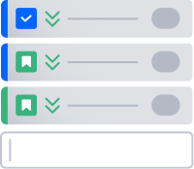
How do scrum & kanban differ?
Scrum
Structured around a series of fixed-length iterations called sprints
Kanban
Emphasizes continual delivery by showing the real-time status of all work items
Notes:
Talking Points: Scrum is perhaps the most widely adopted framework — it’s characterized by short iterations of work (sprints) and the ceremonies that accompany it (stand-ups & sprint planning). Kanban is best known for its continuous style of delivery. A quick way to remember which is which is scrum = sprint, kanban = continuous.
Both scum and kanban frameworks are manifested in a visual board, where issues are moved through a workflow as they get closer to completion.

Slide 11
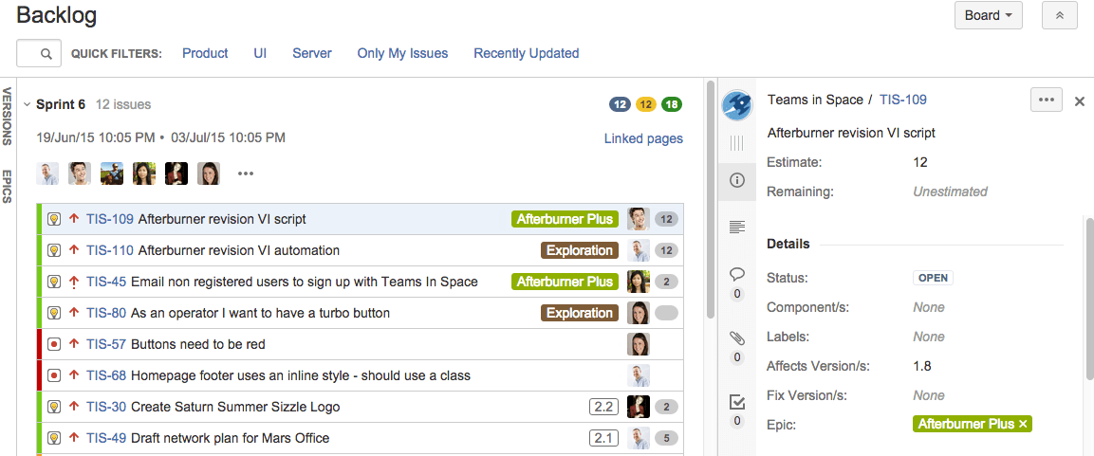
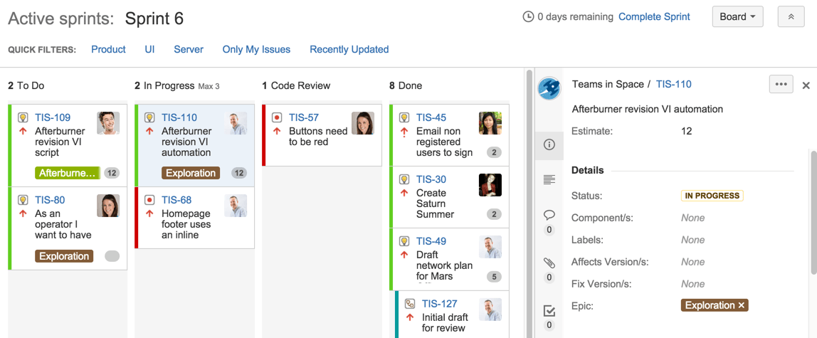
Scrum board
Sprints are determined by pulling work items in from the backlog and estimating time/effort
Notes:
Talking Points: With scrum, the product is built in a series of fixed-length iterations called sprints that usually last about 2 weeks.
Each sprint begins with a sprint planning session where we will choose items from the backlog to be pulled into the sprint. Based on the estimated time/effort of each task and the number of team members contributing, we will can gauge how much work should be added to the next sprint.
Because of these short cycles, good estimation and fast feedback are especially important.
Throughout the duration of the sprint, we will hold daily stand-ups to review what everyone is working on and identify any roadblocks that could keep us from finishing a task in the sprint timeframe.
At the end of each sprint, we will hold a sprint retrospective meeting to identify what we did well and what we can do better. As we are getting started, these will be incredibly important (especially as we improve our estimation of each work item).

Slide 12
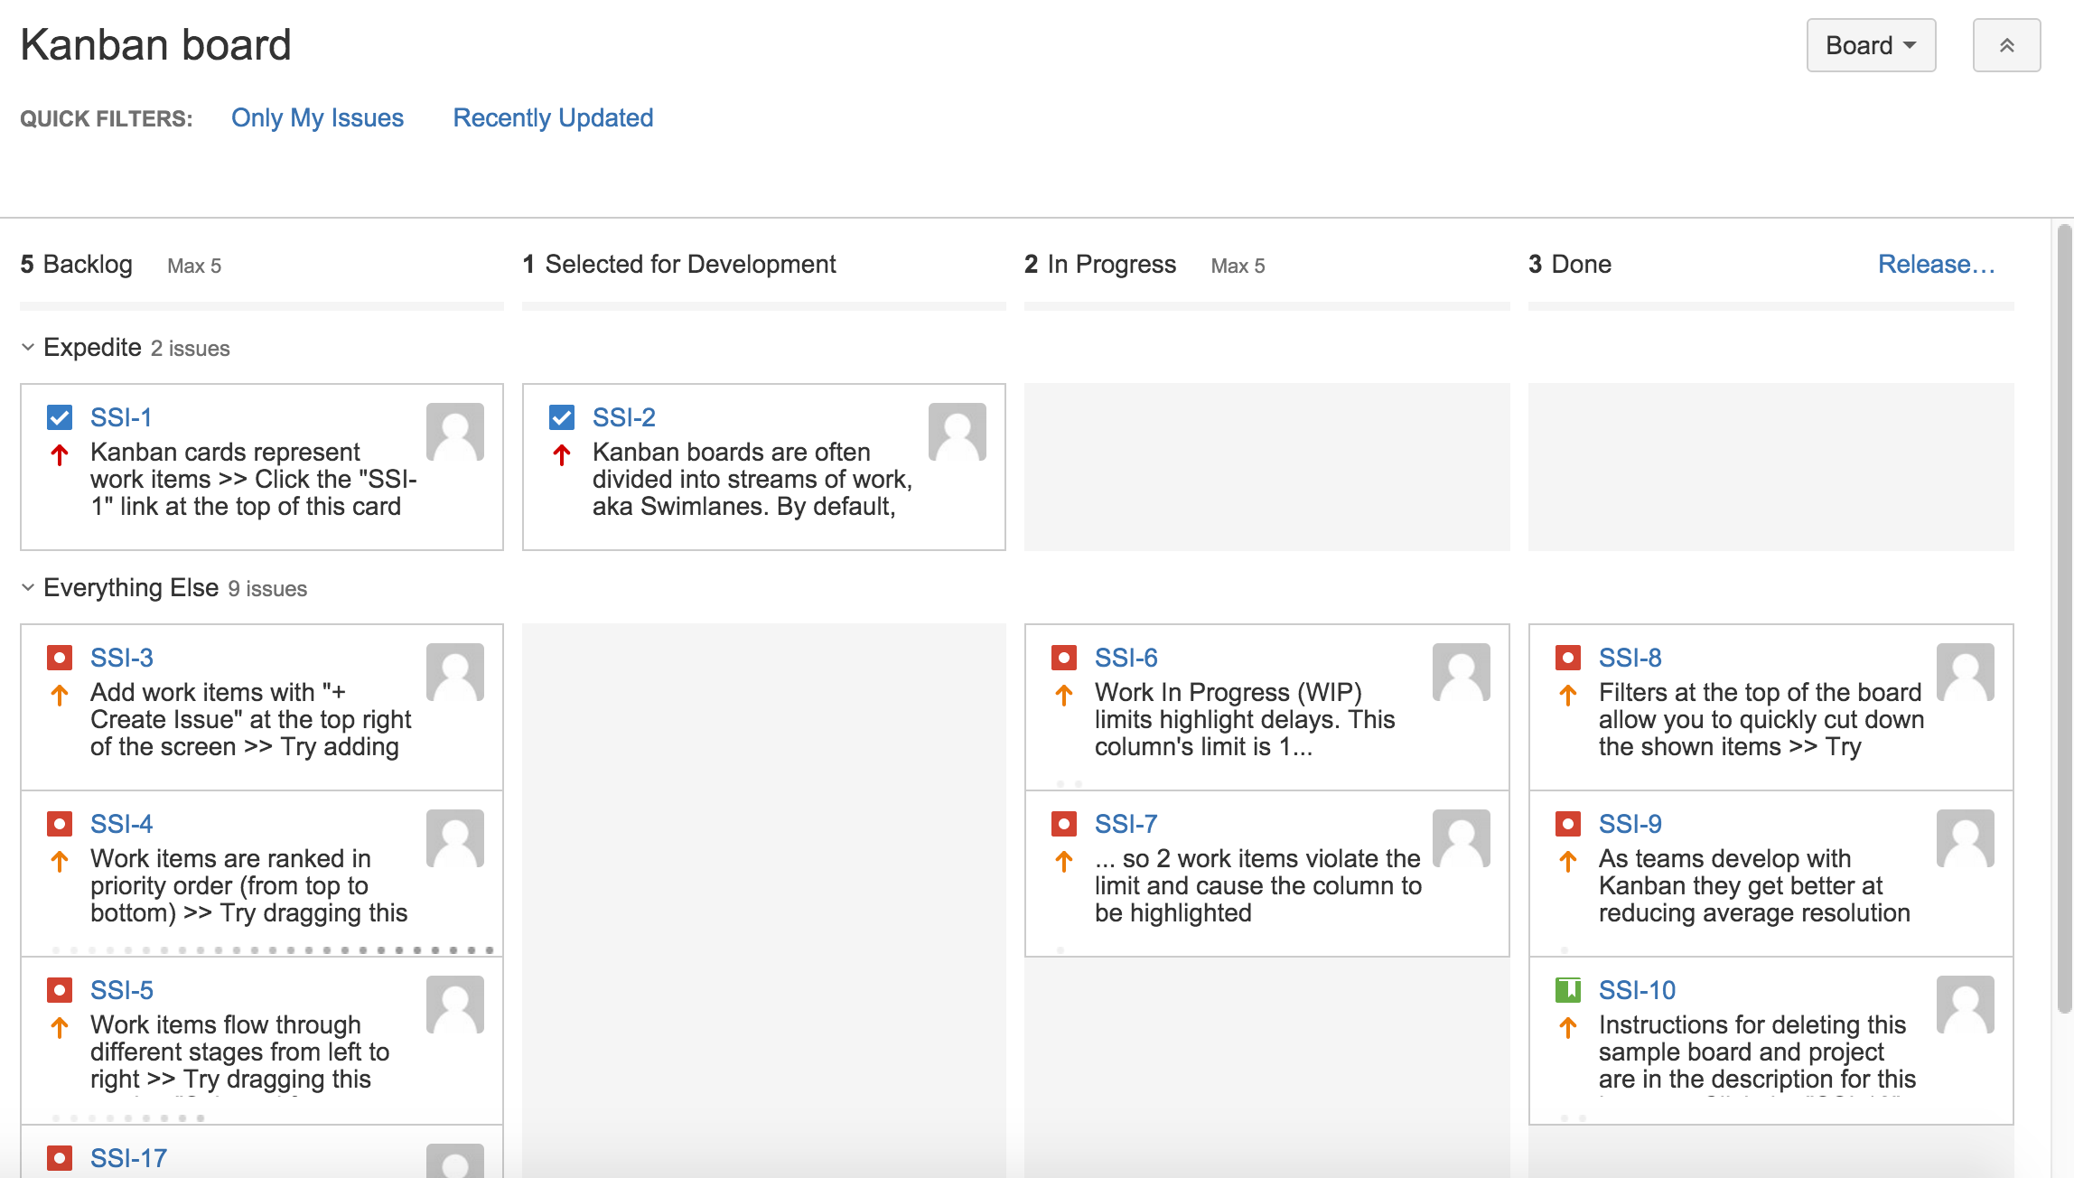
Kanban board
Work is continuously delivered by pulling single pieces of work from the backlog
A classic Kanban board is broken up into: Backlog, Selected for Development, In Progress, and Done
Notes:
Talking Points: Kanban gives more flexibility in terms of planning and execution. Instead of working in time-based sprints, work is continuously delivered in Kanban, as single pieces of work are moved from the backlog and through the workflow until complete.
A key tenant of kanban is to limit the amount of work in progress (WIP). Work-in-progress limits allow us to more quickly detect bottlenecks and backups in our workflow.
Once the optimal WIP flow is achieved, Kanban is also a perfect compliment to continuous delivery (the practice of automatically building and testing code incrementally throughout the day, and releasing to customers). This will allow us to deliver innovation to market — great for us and better for our customers!

Slide 13
Introducing Jira Software
Speaking Jira Software
Agenda
Organizing Jira Software
Working with Jira Software
Mastering Jira Software

Slide 14
Speaking
Jira Software
Ready to learn a new lingo?
Learning Jira can sometimes feel like learning a new language. Let’s break it down together.
Issues = any unit of work
They are tracked through a workflow, through creation to completion.
Make sure to add examples of different issue types you will be using
Issues can be big or small
They can represent a single unit of work or a larger parent work item to be tracked.
Notes:
Note: Emphasize that there are standard terms in Jira, but in most cases they map directly to concepts you are already familiar with.
Talking Points: Issues are one of the most fundamental building blocks in Jira, but can be tricky to master because an issue can represent different things in different contexts.
For us, an issue issue might be an experiment that is tracked from idea to planning to execution to measurement. Or a bug that is tracked from identified to selected to in progress to solved.
That being said, it can be big, like a complex experiment that involves the work of several individuals, or it could be smaller, like a minor bug that requires fixing.

Slide 15
Speaking Jira software
Boards
Visual representation of our work
Projects
A collection of related issues
Issues
Units of work
Notes:
Talking Points: Three of the most basic Jira-specific vocabulary terms that you will hear over and over are boards, projects & issues.
As mentioned earlier, boards are the visual representation of units of work moving through their specific workflow.
A project is a collection of related issues. For us, an example of a project would be a… (software development project / marketing campaign / helpdesk system / leave request management system / website enhancement request system).
And as discussed in the last slide, issues are the specific units of work that make up projects.

Slide 16
But how does it all fit together?
Issue Types:
Epic
Story
Task
Bug
Request
Subtask
PROJECT
EPIC
STORY
TASK
BUG
SUBTASK
SUBTASK
SUBTASK
Notes:
Talking Points: A way to contextualize this might be getting married (the project). There might be several epics associated with a single project, like planning the wedding, planning the honeymoon. Within each epic would would have a number of distinct tasks such as choosing a venue, picking a caterer, making the seating arrangement. And depending on the task, you might even have more granular subtasks, like making sure that Aunt Mildred is not sitting at the same table as Cousin Vinnie.

Slide 17
Issues at [Your Company]
For example…
PROJECT = Add yours
EPIC = Add yours
TASK = Add yours
SUBTASK = Add yours
Add a real example of what a project might be for your team, and a corresponding epic/task/subtask

Slide 18
Speaking Jira Software
A workflow is the lifecycle of an issue, made up of statuses that are connected by transitions
CREATE
START
COMPLETE
TO DO
IN PROGRESS
DONE
ABANDON
Status
Customize the workflow seen here to match what is configured in your instance
Transition
Notes:
Talking Points: Each of these issues will go through a specific workflow. In its simplest form, to-do to in progress to done. Going back to the wedding example, you might be working through the task of finding the right photographer. Before you do any research, it would just sit with the status of To-Do. Once you start working on the task by looking at Yelp, asking friends, compiling a list of potential photographers, and interviewing them, this task would be In Progress. And once you finally make your decision and find your dream photographer, you can resolve the task as Done.
Note: Be sure to highlight the importance of team members keeping their issues up to date!

Slide 19
Introducing Jira Software
Speaking Jira Software
Agenda
Organizing Jira Software
Working with Jira Software
Mastering Jira Software

Slide 20
Beyond boards & issues
Other constructs within Jira that help you keep track of work that transcends single projects
Labels
Ad-hoc organization between (or within) projects
Components
Project-specific areas of team ownership (defined by engineering teams)
Versions
Issues that are scheduled and grouped into specific releases
Notes:
Talking Points: Labels, components & versions all come in handy when you are looking for specific issues. They also provide another layer of organization for issues that might cross into different projects.
Think of Labels as tags. They can help you categorize and search for issues, and also have the benefit of allowing for multiple labels per issue. While any of you can create labels, be judicious with your creation so we don’t end up with label sprawl. Going back to the wedding example, a label we could use might be using “Deposit” if that particular task involved putting down a sum of money.
Components are just sub-sections of a project. They are used to group related issues within a project into smaller parts. (It can be useful to define components which align across multiple projects). Creating components requires admin privileges (Mention who will be tasked with owning and creating them in your org). An issue can also relate to multiple components. In our wedding example, you might break the wedding itself into rehearsal dinner, wedding day, and farewell brunch as separate components. Some tasks might apply to more than one of the events, allowing for multiple components to be specified.
Versions are points-in-time for a project. They help you organize your work by giving you milestones to aim for. You can then assign the issues in your project to a specific version, and build up the work you need to do to complete that version.
(Remember you can remove any of the elements mentioned above that your team will not be using.)
Over time, our Jira instance will get more crowded. As more issues and projects get added, it will become increasingly important to have this level of metadata for easy searchability.

Slide 21
But who has the power to organize?
There are different levels of permission in Jira Software
Your access depends on what you need to do your job effectively
Need help? Ask.
If you need to perform an action and you don’t have permission, ask someone who does. If this becomes a recurring situation, we can discuss changing you permission.
Notes:
Talking Points: In Jira Software, there are System Administrators & Administrators (like name & name). Certain features must be granted access by one of us. Some of these features include things like browsing users, creating shared objects like a dashboard or filter, and making bulk changes.

Slide 22
Introducing Jira Software
Speaking Jira Software
Agenda
Organizing Jira Software
Working with Jira Software
Mastering Jira Software

Slide 23
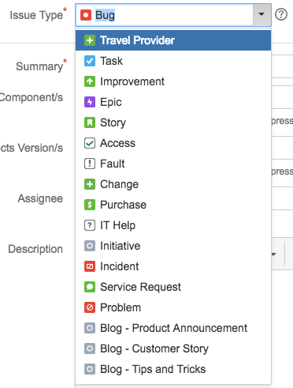
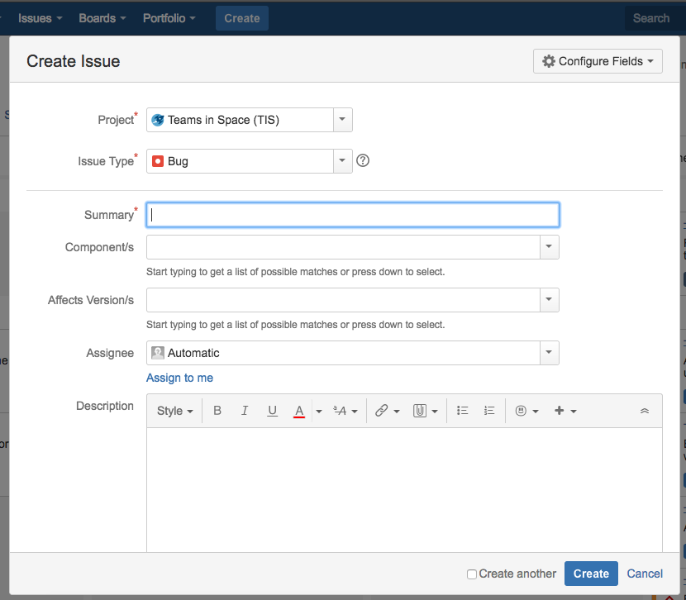
Working with Jira software
Assigning an issue type
Assigning Issues
Creating Issues
Notes:
Talking points: Creating issues for the backlog is a fairly straightforward process. The main things to remember are that you select the correct issue type, and when appropriate, remember to assign the issue to you. Make sure you enter the correct fields when creating issues — this will ensure filters and dashboards correctly reflect work that needs to be done, and work that is complete.
These screenshots are just examples (but feel free to add ones from your instance). One of the reasons we moved to Jira is the ability to customize almost everything. When you’re working in Jira, your view might look a little different than this, but it will have fields that work for the types of projects you’re working on.

Slide 24
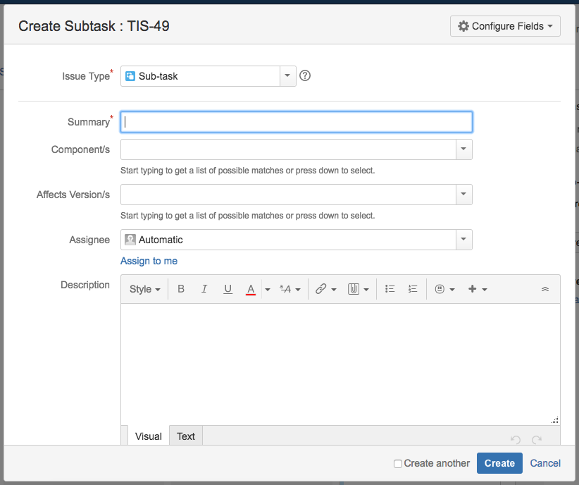
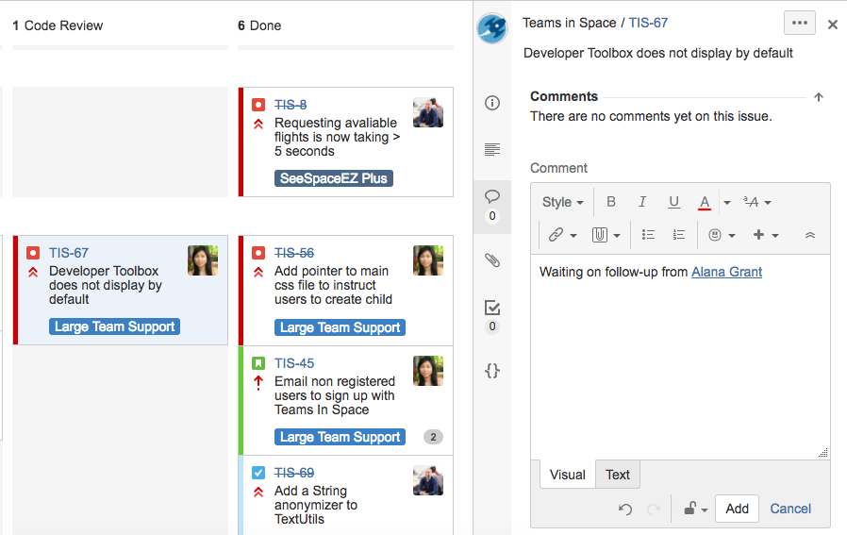
Working with Jira software
Comments
Subtasks
Notes:
Talking points: A subtask is for breaking up an issue into pieces that can be tackled separately. As a reminder, our earlier subtask for our wedding seating chart task making sure that Aunt Mildred is not sitting at the same table as Cousin Vinnie. They are most helpful in situations where a task or story involves different data sets or that you want to give pieces of work to different people, but are still closely tied to the completion of a single task. It is often comes down to personal preference for how much detailed would like to get with each subtask.
Another core component of communication in Jira is via the comments. By @mentioning teammates, you can call their attention to a specific issue, and take many conversations out of silos like email and chat, bringing visibility to everyone else. It's just like mentioning someone on Facebook, but that way you can ensure your teammates get notified.

Slide 25
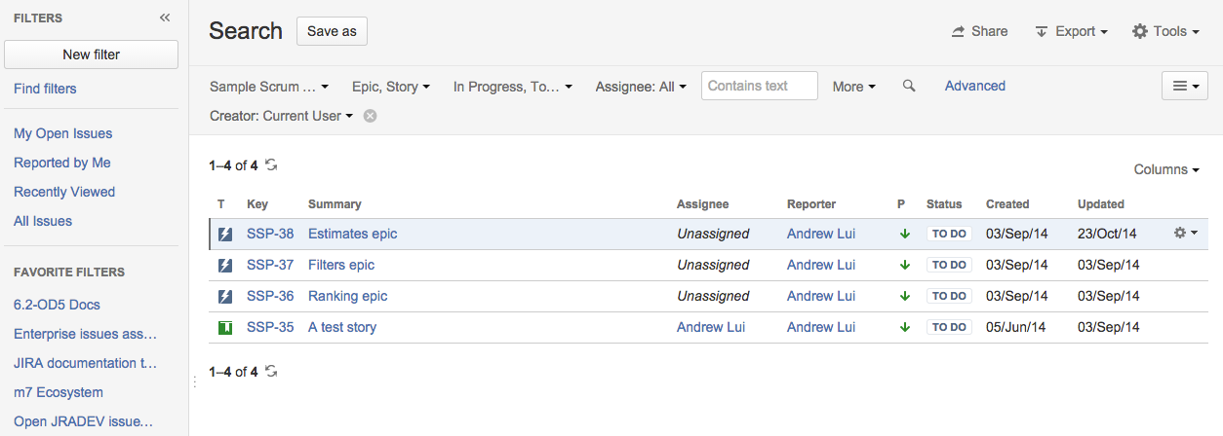
Working with Jira software
Basic Searching
Advanced Searching (using JQL)
Notes:
Talking points: One of the many benefits of moving to Jira is the discoverability of our work. Because there is quick search, basic search & advanced search options, there is always a way to find what you’re looking for depending on how technical you are and how granular you need your search results to be.
With basic search, you can easily select certain criteria against specific fields or text. Its user-friendly interface lets you define complex queries without needing to know any coding language.
Advanced search allows you to build structured queries using JQL, or Jira Query Language. It’s the most flexible way to search for issues in Jira and the best part: you don't have to be technical to use JQL. If you already know SQL, you've got a leg up because Atlassian's implementation of JQL is very similar. If not, that’s okay too! There is plenty of documentation to get you started, and you will have lots of time to practice.
Another handy thing about Jira searches is that they can be easily saved for future use — more on that later.

Slide 26
Introducing Jira Software
Speaking Jira Software
Agenda
Organizing Jira Software
Working with Jira Software
Mastering Jira Software

Slide 27
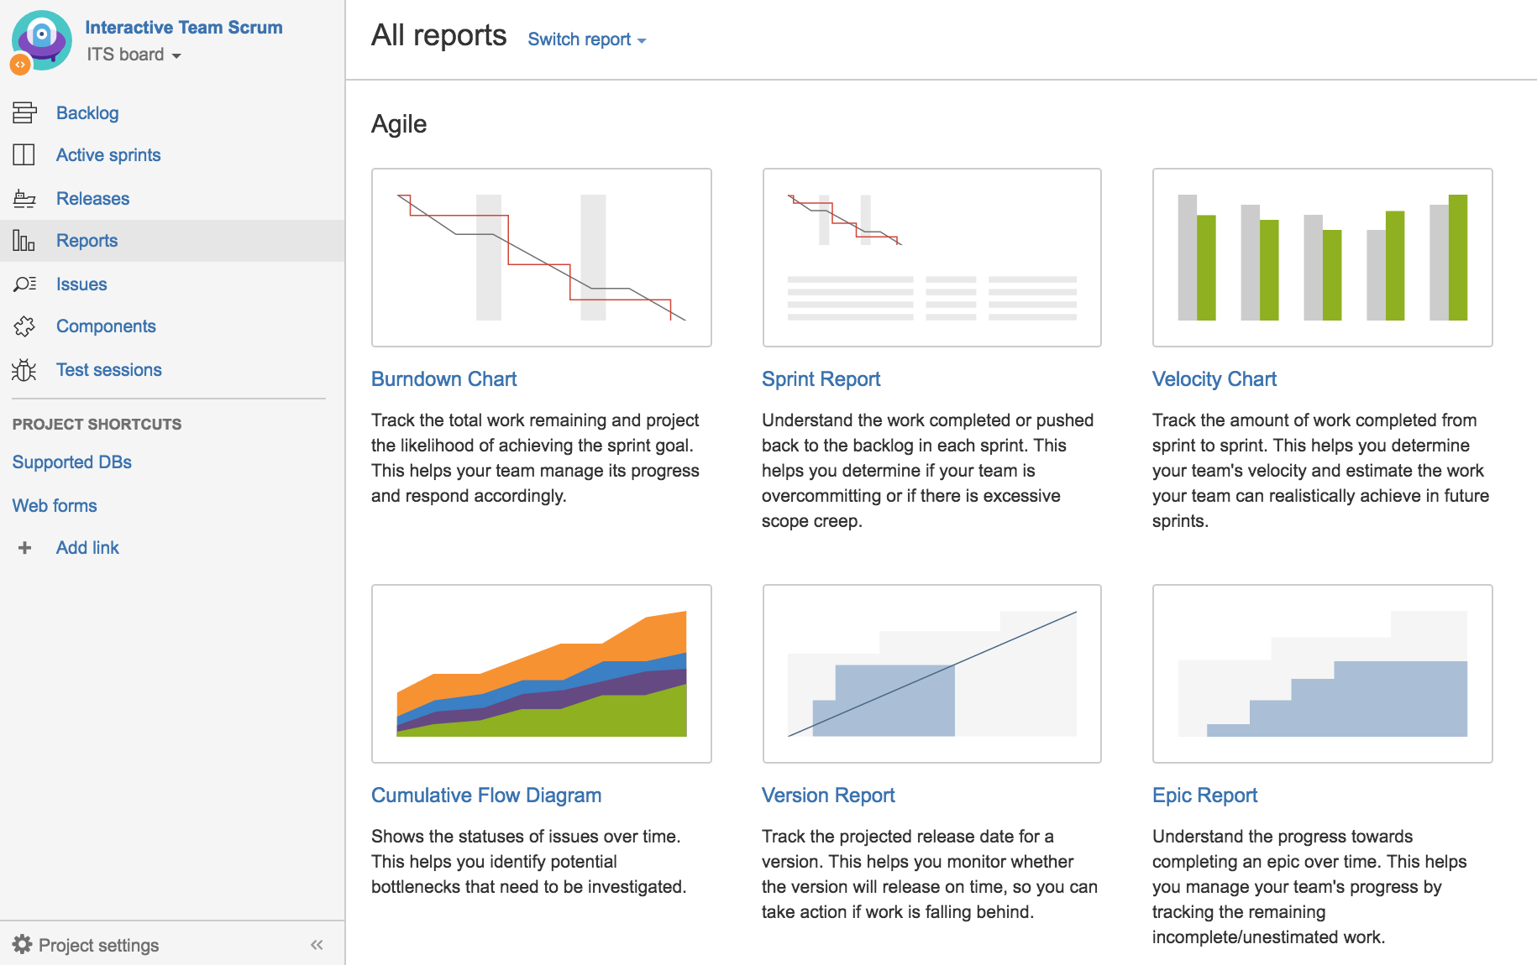
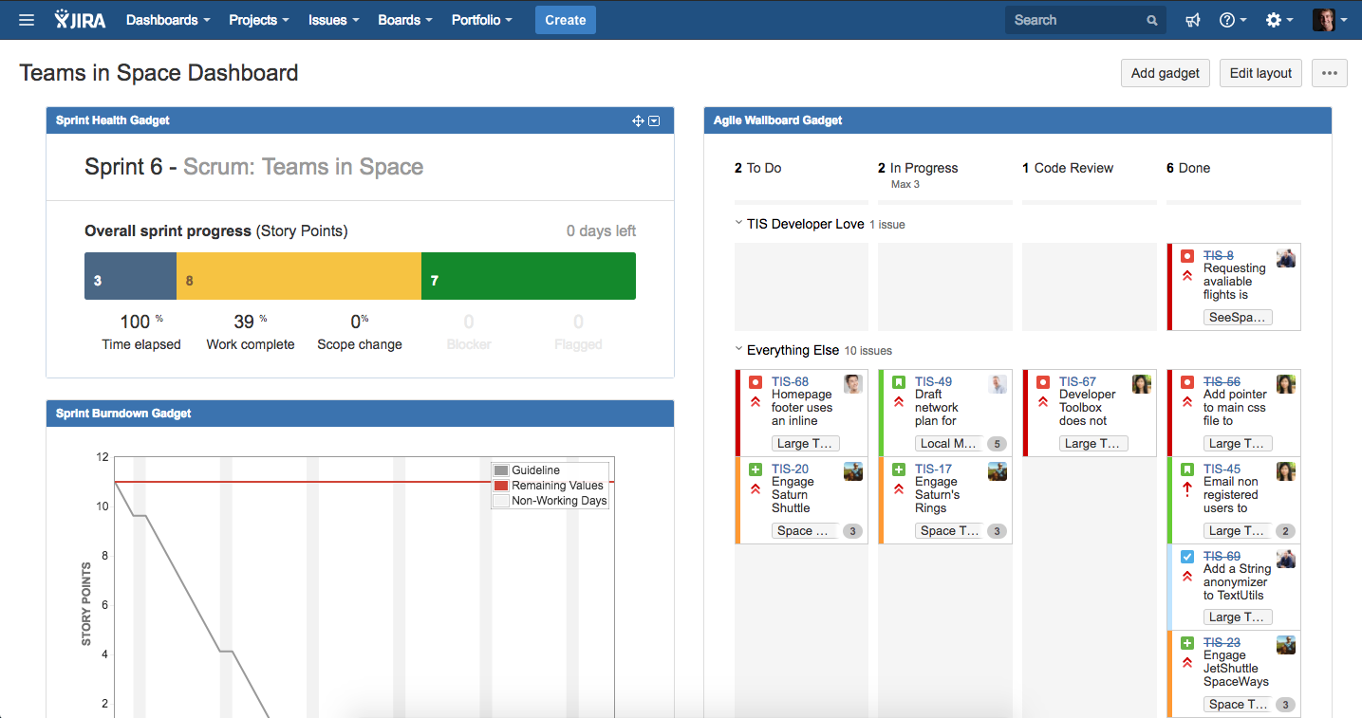
Mastering Jira Software
Bring visibility to your work via…
Dashboards
reports
Notes:
Talking points: A huge benefit of adopting Jira Software is the ability to understand status and progress in a visual way. Both reports and dashboards are powerful ways to bring visibility to your work.
Reports are most often used by team leads to pull and track progress of their team's work. They’re great to reference at standups, and to report progress out to stakeholders. Reports are static, showing the data at the time you run the report.
The dashboard, on the other hand, is a living, breathing thing. Dashboards can be fully customized, and are made up of a collection of gadgets that allow you to display certain reports and visuals all in one place. You can make your own dashboard, pulling in things that are meaningful to you, such as a quick view of all issues assigned to you. Dashboards are often the first thing you see when you log in, making them a useful tool for prioritization of your work.
There is an innate level of overlap between dashboards and reports. For example, you can have a Burndown Chart report and a Burndown Gadget on a dashboard.

Slide 28
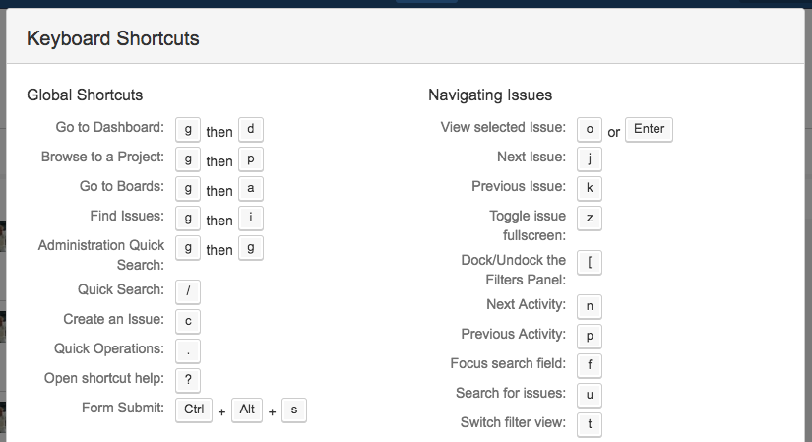
Quick Tips
Filters
Quickly find issues assigned to you, or create your own custom filters
Keyboard Shortcuts
The ? button will pull up all the keyboard shortcuts available
Notes:
Talking points: There are a ton of ways to increase efficiency once you master the basics of Jira Software. Two examples that you can start utilizing right away are filters and some of the basic keyboard shortcuts.
The are some pre-built filters (such as only looking at issues assigned to you), but you can also save any of the different types of searches we discussed earlier as a filter. One example might be setting up a filter so you get an update anytime there is an update on an issue assigned to you. While anyone can create their own filters, only some users have the power to share filters with others.
Keyboard shortcuts are another example of a way to increase efficiency when using Jira Software. Try out the / for quick searching.

Slide 29
So what’s next?
Time to roll out
You will get access to Jira Software starting on date.
All future work in Jira
Starting date all work items to be completed in the future will exist as issues in Jira Software.
Our first sprint starts date
Carve out time to familiarize yourself with Jira & ask any questions you might have before then.
Notes:
Note: Edit this slide as appropriate. We suggest giving your team insight into the roll-out plan to give them runway to make the necessary preparations on their end (as well as mentally prepare!).

Slide 30
Questions?
Email: (Add an email for an IT contact or help desk)
Office Hours: ______ @ X:00
Notes:
Note: We recommend holding regular office hours, especially during the first few weeks of your roll-out. It will give members of the team a chance to work through questions and feel confidence with a new tool and style of working.

